Slide 1
Sprint # 4 Plan
Team B

Slide 2
Outline
Use Case Diagram
Sprint Backlog
Product Backlog
Detailed Use Cases
Acceptance Tests

Slide 3
Use Case Diagram
Class Scheduler
Configure Student Options
Student
Generate Schedule
Advisor
Modify Class List
Completed
Add/Remove Degree of study
Sprint
Backlog
System
Administrator
Product
Backlog

Slide 4
Use Case Diagram
Class Scheduler
Generate Schedule
One Year
Two Year
Student
Advisor
Four Year
Multiple Majors
Graduation Requirements
Hours Limitations
Completed
Sprint
Backlog
Certain Classes Taken
Product
Backlog

Slide 5
Use Case Diagram
Class Scheduler
Configure Student Options
Grad Time Requirement
Certain Classes Taken
Student
Advisor
Hours Limitations
No Classes on Certain Days
Completed
Sprint
Backlog
Product
Backlog

Slide 6
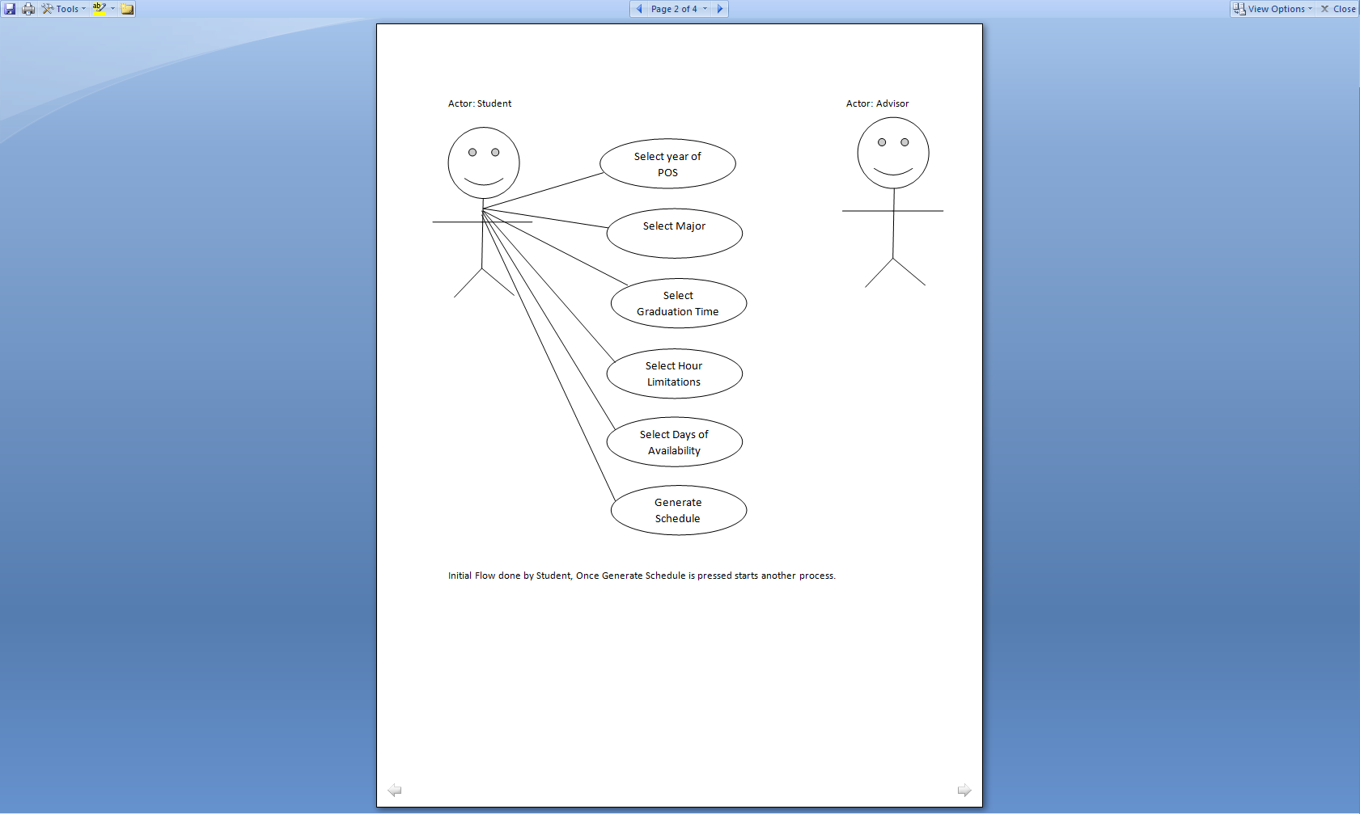
Configure Student Options (Breakdown)

Slide 7
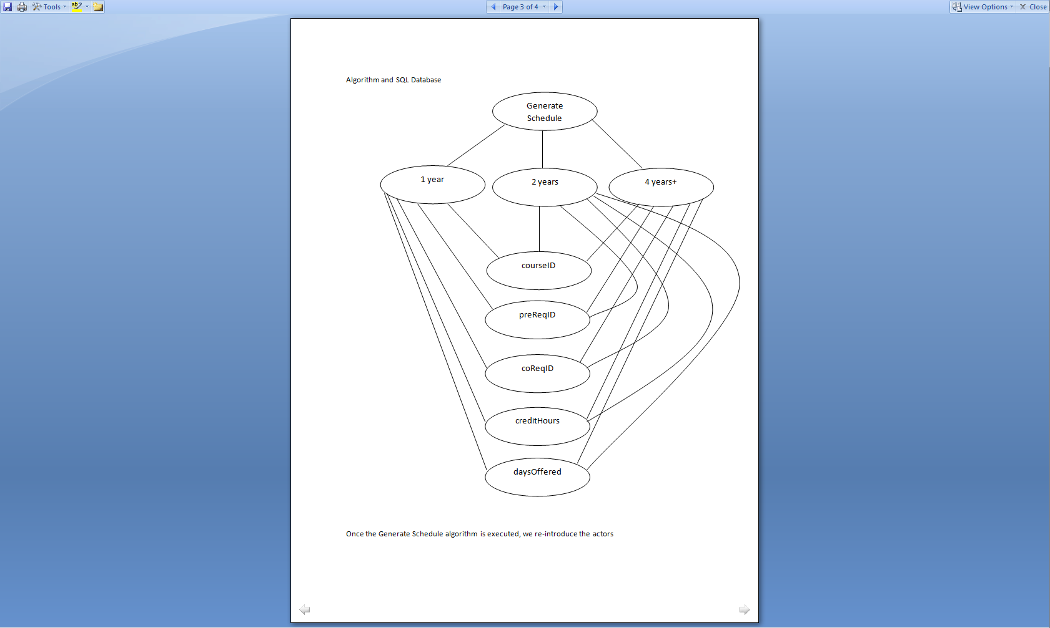
Generate Schedule(Breakdown)

Slide 8
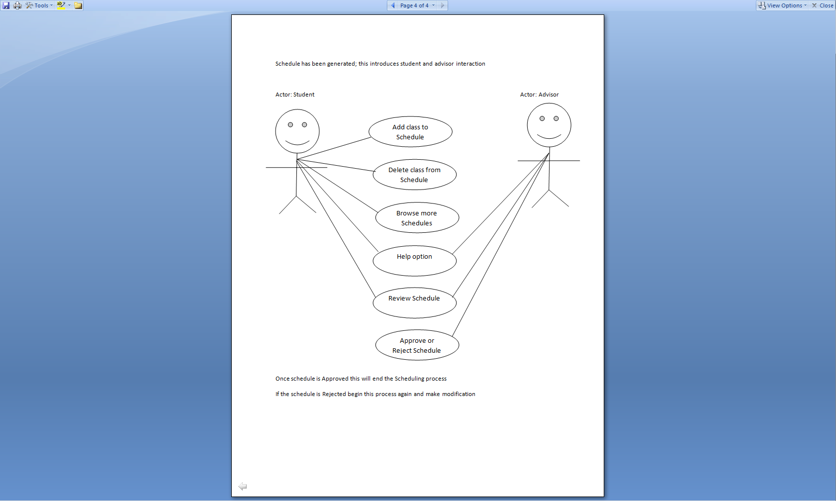
Modify, Add Remove(Breakdown)

Slide 9
Sprint Backlog
Use Case # | Description | Start Date | Hours | Developer | Story Points
2.1 | Generate 2 year schedule : integrate algorithm with SQL As a developer, I want the user to be able to generate multiple schedules based on the user parameters, the algorithm should load information from SQL DB. | 11/7/12 | 10 | Adrian, Chris | 5
Task 1 | Develop Storyboard As a developer, I want to be able to create a visual of all steps of the final product to the user before complete implementation | 11/7/12 | 20 | Natalie | 6
Task 2 | Product Functionality As a developer, I want to be able to map out final product functionality. How do I as a developer want the product to maneuver and is it user friendly for the customer | 11/7/12 | 10 | ALL | 5
2.2 | Generate Schedules (efficiently) As a developer, I want to be able to generate schedules in a reasonable amount of time that is agreeable to the customer | 11/7/12 | 20 | Nick, Chris | 6
2.3 | Generate 4 year schedule: develop default schedule As a developer, I want the user to be able to generate multiple schedules based on the user parameters, for initial purposes there is a need for a default testing schedule | 11/7/12 | 4 | Nick | 2
 |  | Hours | 64 | Story Points | 24

Slide 10
Product Backlog
Use Case# | Item | Description | Story Points
01 | Configure Student Options | As a student or academic advisor, I need to be able to set up a student's settings, such as major, limits on classes per semester, setting graduation times and workable days. | 8
02 | Generate Schedule | As a student or academic advisor, I need to be able to generate a schedule, given a student's degree parameters. This will start with a student in a one year degree and then progress to a real four year degree. | 8
03 | Modify Class List | As a system administrator, I need to be able to modify the classes offered each semester and input their time, place, and teacher into the system. | 8
04 | Add/Remove Degree of Study | As a system administrator, I need to be able to add new degrees of study to the system whenever they are available and remove older ones when they are outdated. | 8
 |  | Total | 32

Slide 11
Use Case Number: 2.1
Use Case Name: Generate 2 year schedule: integrate algorithm with SQL
Actors: Developer
Summary: As a Developer, I want the student or advisor to be able to generate multiple schedules, this shall be done by
developing an algorithm that will retrieve information from
the SQL DB.
Description of Main Flow: Customer will be able to generate a 2 year schedule based on their set parameters.
1. Student will be able to select their parameters for their degree
2. Student will make selection from GUI: Select school year, Select Major,
Graduation Time Frame, Hours per semester and days of availability.
3. Student will be able to get options based on their selection.
4. Student will be able to generate their schedule based on their selection.
5. System will verify the selection is valid.
5. Select Save command.
6. System saves Student data for later use.
Alternative Flow #1: User has input invalid option
4*. System indicates one or more options are illegal and returns to step 2

Slide 12
Use Case Number: 2.2
Use Case Name: Generate Schedules(efficiently)
Actors: Developer
Summary: As a developer, I want to be able to generate schedules in a reasonable amount of time that is agreeable to the customer
Description of Main Flow: Customer will be able to generate schedules at a reasonable amount of time, differences of parameters should not create a long wait time. Need an effective algorithm for most cases.
1. Student will select their parameters for their degree
2. Student will not have to wait for a substantially amount of time for results
3. Student will be able to get options based on their selection.
4. Student will be able to generate their schedule based on their selection.
5. System will verify the selection is valid.
5. Select Save command.
6. System saves Student data for later use.
Alternative Flow #1: User has input invalid option
4*. System indicates one or more options are illegal and returns to step 2

Slide 13
Use Case Number: 2.3
Use Case Name: Generate 4 year schedule: develop default schedule
Actors: Developer
Summary: As a Developer, I want the student or advisor to be able to generate multiple schedules, this shall be done by the user
being able to select the correct degree requirements
Description of Main Flow: Customer will be able to generate a 4 year schedule based on their set parameters.
1. Student will select their parameters for their degree
2. Student will make selection from GUI: Select school year, Select Major,
Graduation Time Frame, Hours per semester and days of availability.
3. Student will be able to get options based on their selection.
4. Student will be able to generate their schedule based on their selection.
5. System will verify the selection is valid.
5. Select Save command.
6. System saves Student data for later use.
Alternative Flow #1: User has input invalid option
4*. System indicates one or more options are illegal and returns to step 2

Slide 14
Use Case Number: 2.3
Use Case Name: Generate 2 year schedule: develop default schedule
Actors: Developer
Summary: As a Developer, I want the student or advisor to be able to generate multiple schedules, however the need for a
we need a default schedule for testing purposes
Description of Main Flow: Customer will be able to generate a 2 year schedule based on their set parameters.
1. Student will select their parameters for their degree
2. Student will make selection from GUI: Select school year, Select Major,
Graduation Time Frame, Hours per semester and days of availability.
3. Student will be able to get options based on their selection.
4. Student will be able to generate their schedule based on their selection.
5. System will verify the selection is valid.
5. Select Save command.
6. System saves Student data for later use.
Alternative Flow #1: User has input invalid option
4*. System indicates one or more options are illegal and returns to step 2

Slide 15
Acceptance Tests
Test # | Purpose of Test | Graduation Time | Hours per Semester | Expected Result
2.1 | Main Flow -Testing the integration between the SQL, GUI, and Algorithm | Tester will use 2 and 4 year | 15 | The data is being pulled from the DB and a display of a schedule is produced
2.2 | Main Flow – Testing that the newly improved algorithm generates a schedule at a reasonable amount of time, with varying options – including options for already taken classes. | Tester will use 2 and 4 year | 15 | The schedule will be produced in a reasonable of time ~10 mins at most
2.3 | Main Flow – Testing that the product will be able to produce a 2 year default schedule | Tester will use 2 year and if successful 4 year | 15 | The schedule will be displayed correctly based on the given parameters

